Slide 1

Strategic Policy Planning: Caladan's COVID-19 Response
Team 1 Presents

Slide 2





Our Team
Aidan Clark
Emily Forman
Data/BI Analyst
Project Manager
Naman Nagaria
Abigail Merage
Patrick Soong
Data Architect
Data Engineer
Project Manager
Stakeholders
Key Players
Methodology
Case Overview
Data Architecture
Relevant Law
Analysis Process
Recommendation
Situation Overview
Decision & Recommendation
2
2

Slide 3
Agenda
01
02
03
Recommendation
Data Architecture
Situation Overview
05
06
07
Analysis
Power BI
Machine Learning
04
Methodology
Situation Overview
Data Architecture
Methodology
Analysis Process
Recommendation
2

Slide 4

Situation Overview
01

Slide 5

Objective
Develop a strategic plan to address the upcoming wave of COVID-19 in Caladan.
Our guiding question: Which minimally restrictive measures can Caladan adopt to ensure that the death growth rate remains under 1% and the new case growth rate stays below 3% over a 30-day moving average?
Situation Overview
Recommendation
Stakeholders
Methodology
Case Overview
Key Players
Data Architecture
Relevant Law
Decision & Recommendation
Analysis
Power BI
Machine Learning
2
2

Slide 6
Situation Overview:
Commonwealth of Caladan
Current Scenario
Population: 3.2 million Urban Centers: Duncan and Stillgard COVID-19 Impact: Low, with concerns of a potential resurgence
Strategy
Examine the effectiveness of policies from ten representative countries in managing the growth rates of COVID-19 cases and deaths. Our goal is to identify which measures have been the most successful in curbing the spread of the virus.
Stakeholders
Stakeholders
Methodology
Situation Overview
Recommendation
Methodology
Key Players
Key Players
Data Architecture
Data Architecture
Relevant Law
Case Overview
Relevant Law
Analysis Process
Recommendation
Case Overview
Decision & Recommendation
Situation Overview
Decision & Recommendation
Analysis
Power BI
Machine Learning
2
2
2
2

Slide 7

Recommendation
02

Slide 8

3 Most Effective Policies -
Our Recommendation
Internal Movement Regulation
Public Transport Regulations
School Closures
Stakeholders
Stakeholders
Methodology
Situation Overview
Recommendation
Methodology
Key Players
Key Players
Data Architecture
Data Architecture
Relevant Law
Case Overview
Relevant Law
Analysis Process
Recommendation
Case Overview
Decision & Recommendation
Situation Overview
Decision & Recommendation
Analysis
Power BI
Machine Learning
2
2
2
2

Slide 9

Data Architecture
03

Slide 10
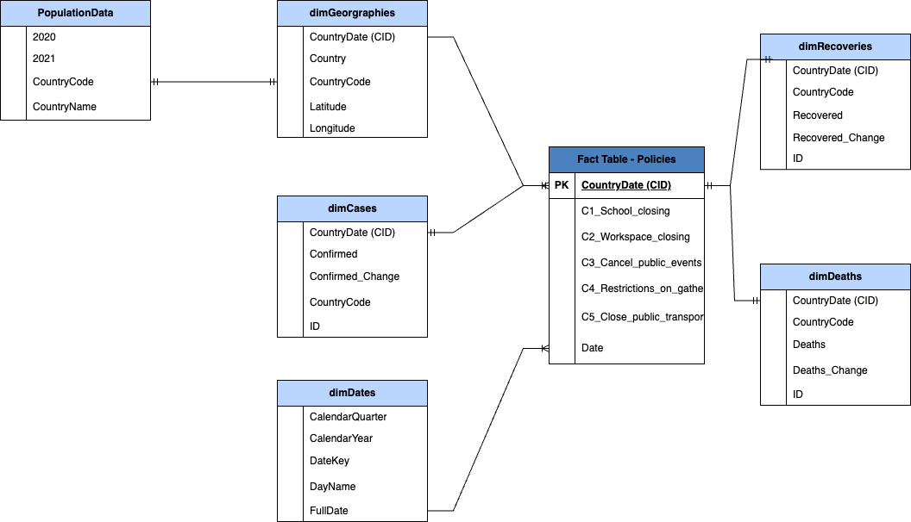
Schema Model
Situation Overview
Recommendation
Stakeholders
Methodology
Case Overview
Key Players
Data Architecture
Relevant Law
Decision & Recommendation
Analysis
Power BI
Machine Learning
2
2

Slide 11
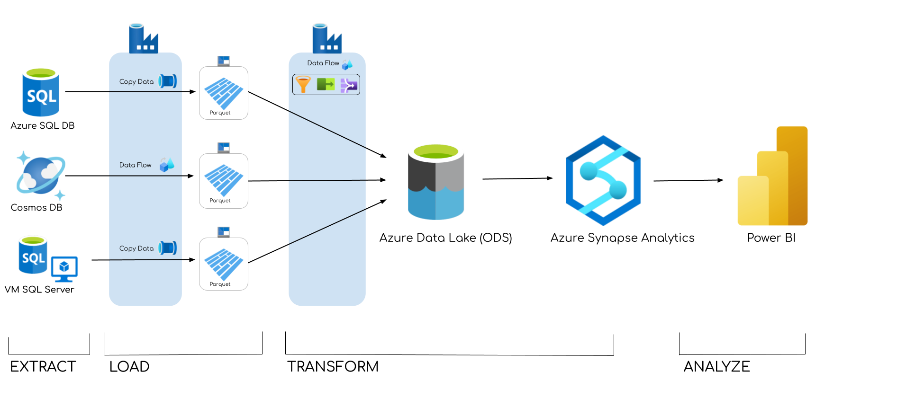
Data Transformation Model
Situation Overview
Recommendation
Stakeholders
Methodology
Case Overview
Key Players
Data Architecture
Relevant Law
Decision & Recommendation
Analysis
Power BI
Machine Learning
2
2

Slide 12

04
Methodology

Slide 13
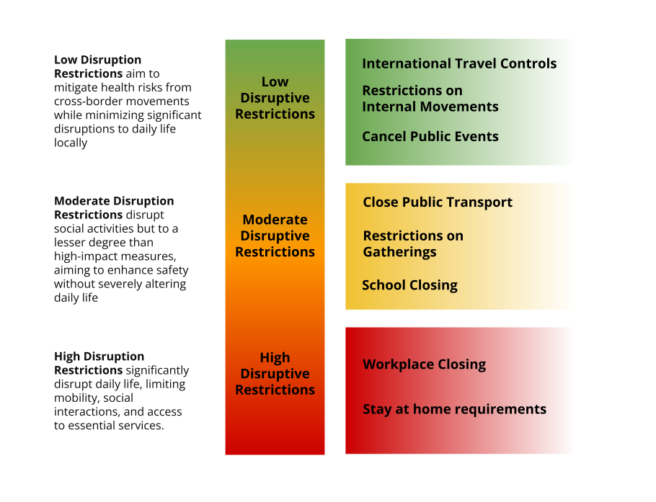
Scale of Restriction
es Schwab Revenue Growth Over time
To begin our analysis, Team 1 created a scale of policy restrictiveness based on disruption to everyday life
Situation Overview
Recommendation
Stakeholders
Methodology
Case Overview
Key Players
Data Architecture
Relevant Law
Decision & Recommendation
Analysis
Power BI
Machine Learning
2
2

Slide 14

Analysis
05

Slide 15
Analysis Process
Step 3
Step 2
Confirm our exploratory analysis and ideas with the use of statistical findings
Utilizing a combination of a key influencer graph and a logistical regression, we can confirm our findings of what policies tend to reduce growth rates when compared to the overall averages
Step 1
Isolate specific policies based off the average policy score throughout the chosen time period
Overlay changes in policy restriction with rolling averages, seeking signs of implemented policy changes impacting the growth rate of cases/deaths
Using rolling average of growth rate of deaths and cases, decide time period for top 3 countries with the most successful growth and death rates
Analyze when our growth rate rolling average falls below 3% for cases and 1% for death
Stakeholders
Stakeholders
Methodology
Situation Overview
Recommendation
Methodology
Key Players
Key Players
Data Architecture
Data Architecture
Relevant Law
Case Overview
Relevant Law
Analysis Process
Recommendation
Case Overview
Decision & Recommendation
Situation Overview
Decision & Recommendation
Analysis
Power BI
Machine Learning
2
2
2
2
Notes:
Compare this time period to our heat map to determine the least restrictive policies that were implemented during this time

Slide 16

Power BI
06

Slide 17
Logistic Regression
jef
Cases Regression
Deaths Regression
Predictor | Coefficient | Odds Ratio
Closing Public Transport | -3.188 | .04
No Gatherings | -1.72 | .18
School Closing | -1.57 | .21
Controlling International Travel | -1.35 | .26
No Internal Movements | -1.34 | .26
Predictor | Coefficient | Odds Ratio
Closing Public Transport | -2.02 | .13
No Internal Movements | -1.22 | .29
No Gatherings | -1.10 | .33
Closing Work | -.80 | .45
Controlling International Travel | -.69 | .50
Public Information Campaigns | -.65 | .52
Government Response Index | -.56 | .57
School Closing | -.45 | .64
Stakeholders
Stakeholders
Methodology
Situation Overview
Recommendation
Methodology
Key Players
Key Players
Data Architecture
Data Architecture
Relevant Law
Case Overview
Relevant Law
Analysis Process
Recommendation
Case Overview
Decision & Recommendation
Situation Overview
Decision & Recommendation
Analysis
Power BI
Machine Learning
2
2
2
2

Slide 18
Machine Learning
07

Slide 19

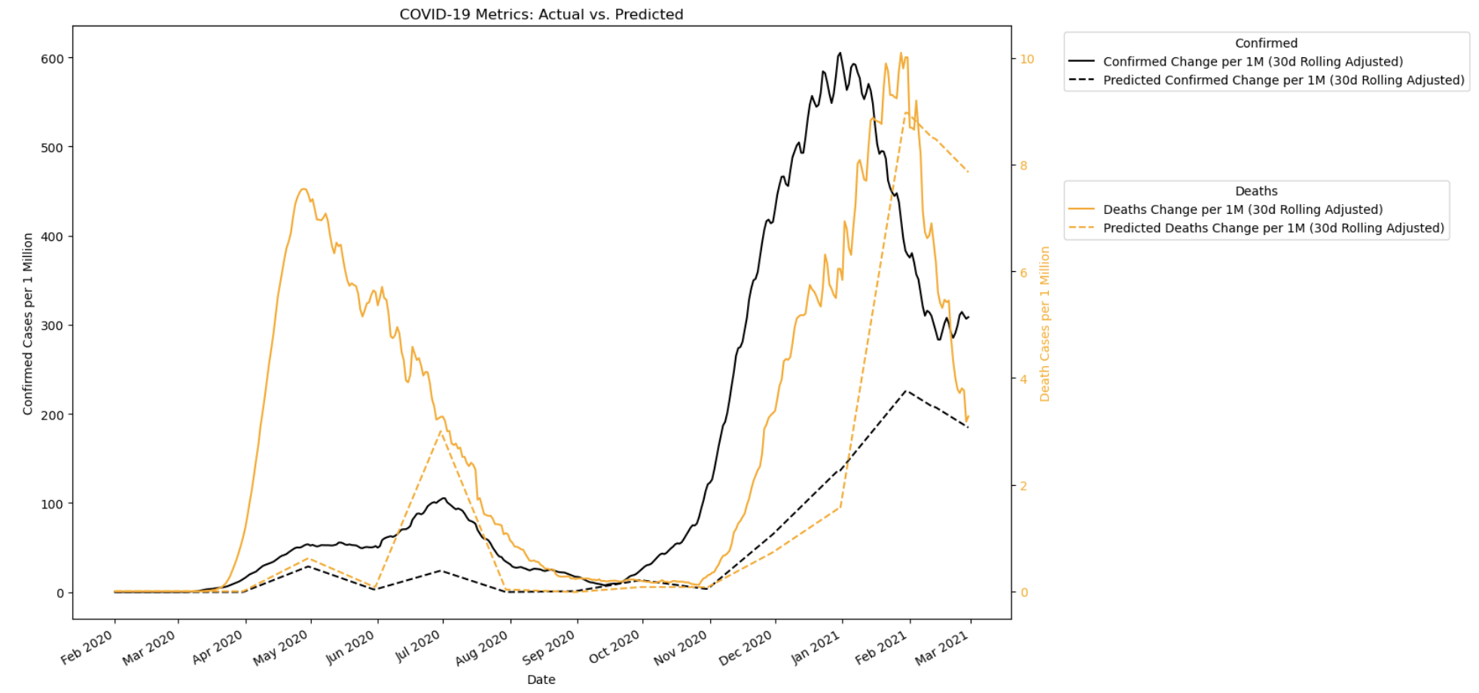
Machine Learning Modeling
The dotted line represents the confirmed change in cases if Sweden implemented our recommendations earlier
Indicador 4
Stakeholders
Stakeholders
Stakeholders
Methodology
Situation Overview
Recommendation
Methodology
Key Players
Key Players
Key Players
Data Architecture
Data Architecture
Relevant Law
Relevant Law
Case Overview
Relevant Law
Analysis Process
Recommendation
Case Overview
Case Overview
Decision & Recommendation
Decision & Recommendation
Situation Overview
Decision & Recommendation
Analysis
Power BI
Machine Learning
2
2
2
2
2
2
Notes:
transition- how does this strategy translate into the marketing segment of each company

Slide 20

Thank You!

